Slide 1

Shintsha
A Decentralized Online Market: Connecting Farmers with Buyers in Minutes!!!
Beyond Blockchain Hackathon
Consensys Labs Relay 2:
Designing an Open Transaction Economy

Slide 2
Preview
The agricultural business has revolutionized in recent years but still faces multiple challenges. The supply chain has been faced with the non-transparent, inefficient and noncommunicating network made up of processes, data, actors, and products. Disconnection and lack of transparency complicate issues of fair pricing and quality of products.
The need for data integration has resulted from the regulatory pressure, scandals and food crises. Transfer of funds to business partners in other countries without delay or worry of fraudsters. Blockchain will play an important role in supply chain intelligence for technology that facilitates easy traceability of product information. We aim to provide direct access to enable farmers reach their investors without the assistance of middle-men. Farmers can directly interact with customers via WhatsApp, take orders, investors can make payment and farmers can advertise their products to investors, all these information is stored via smart contracts in the blockchain, enabling transparency, trust and fostering an open transaction economy .

Slide 3
Limitation faced by farmers in Africa
The agricultural sector in Africa remains the main source of livelihood for a large proportion of the continent’s population and a significant contributor to the GDP. In Africa, agriculture and the innovation around agriculture fundamentally continue to be a catalyst of sustainable development primarily for enhanced food security, secondary, in the reduction of poverty and the overall growth of the continent’s economy. The sector grapples with a myriad of problems. The agriculture ecosystem in Africa is broken at all levels right from the crop and livestock production level to the last mile of reaching consumers. The challenges can thus be classified as follows;
Primary production- Farmers hardly receive quality fertilizer and seeds, lowering productivity to 10% of the global average for almost every crop.
Pricing information & access to markets- Farmers do not have access to current information on market prices or even access to the trading markets thus demand & supply can’t be matched. This also creates a loophole for middle-men who control the market conditions.
Access to financial services- Most farmers in Africa practice small-scale farming and a majority do not have access to bank accounts. Most are therefore undocumented with any financial services thus making their creditworthiness hard to determine. Due to this, many have no access to credit which they require to scale their farming.

Slide 4
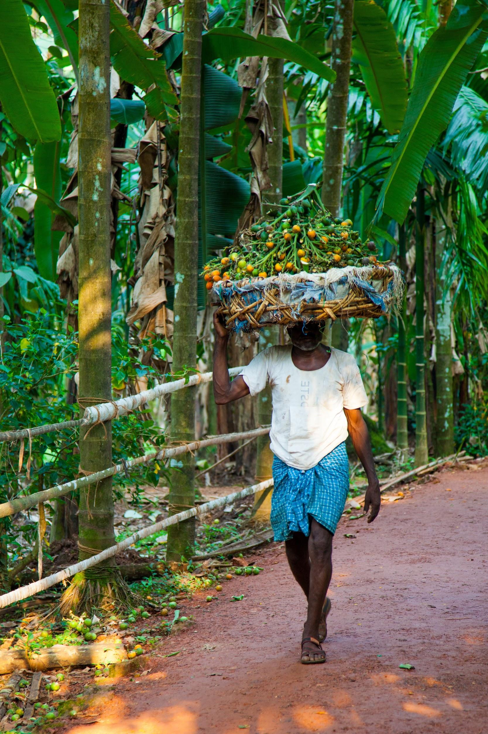
Use Case
Mr. Obi is an organic farmer from South Africa who has a plantation, he aims to increase his productivity during the harvesting season, to achieve this he needs direct access to investors so as to enable him get funding to expand his business.
To expand his business he needs a way to trade in other currencies beside the rand, accepting international payments would also mean that his consumers would need to verify the authenticity of his products before purchase.
He also envisions a system where he can get trusted ratings for his work from consumers of his products, and this ratings could be used by credit institutions to grant him access to soft loans.

Slide 5
Questions we seek to answer
Can blockchain technology be deployed to automate the value chain from the farmer to the consumers? Why Whatsapp? Why Africa?
How do we create an open economy where consumers can access Mr. Obi, and he can in turn access his investors without the assistance of middlemen and how can he prove the authenticity of the crops he produces to his investors?
Can Mr. Obi build a good reputation represented in kudos or NFTs , showing his trusted rating to investors for easy access to credit?
How do we instill trust and transparency among different players when using the SHINTSHA blockchain platform?

Slide 6
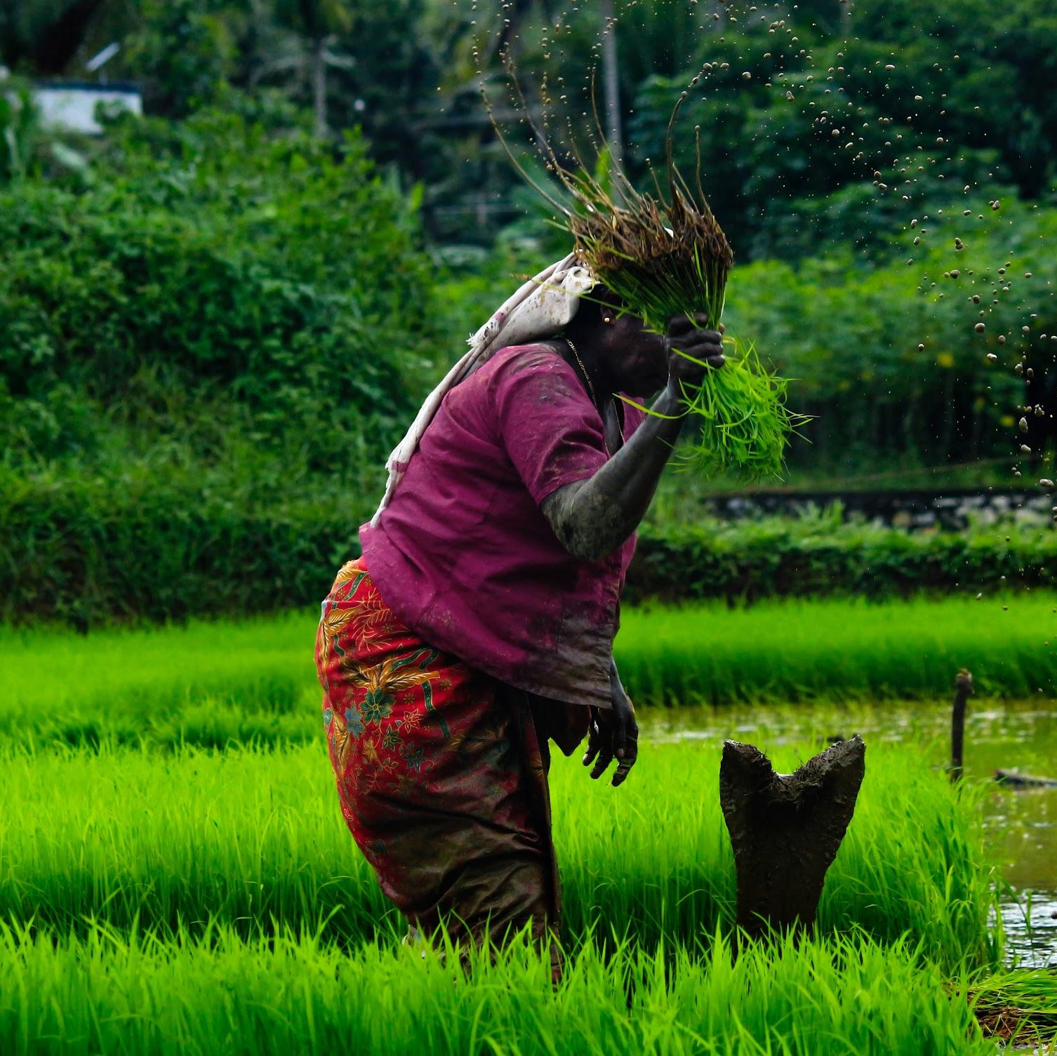
Current Alternatives: Middlemen
Middlemen has for long being a source of concern for farmers as they are being underpriced for goods they produce,since they can’t access the mainstream market either due to their remote location or inaccessibility to consumers.
Mr. Obi has harvested new organic produce from his plantation and he needs to sell them, he goes to the middleman (Wholesaler, retailer etc) to negotiate prices,after which they both agree on a price.
The wholesaler/retailer then sells to a consumer for double the amount he purchased from Mr. Obi leading to inconsistency and fluctuation in prices.
Mr. Obi goes home with less than his product worth, with this rate he wouldn’t be able to expand his business and purchase good nutrients needed for his organic farm.

Slide 7
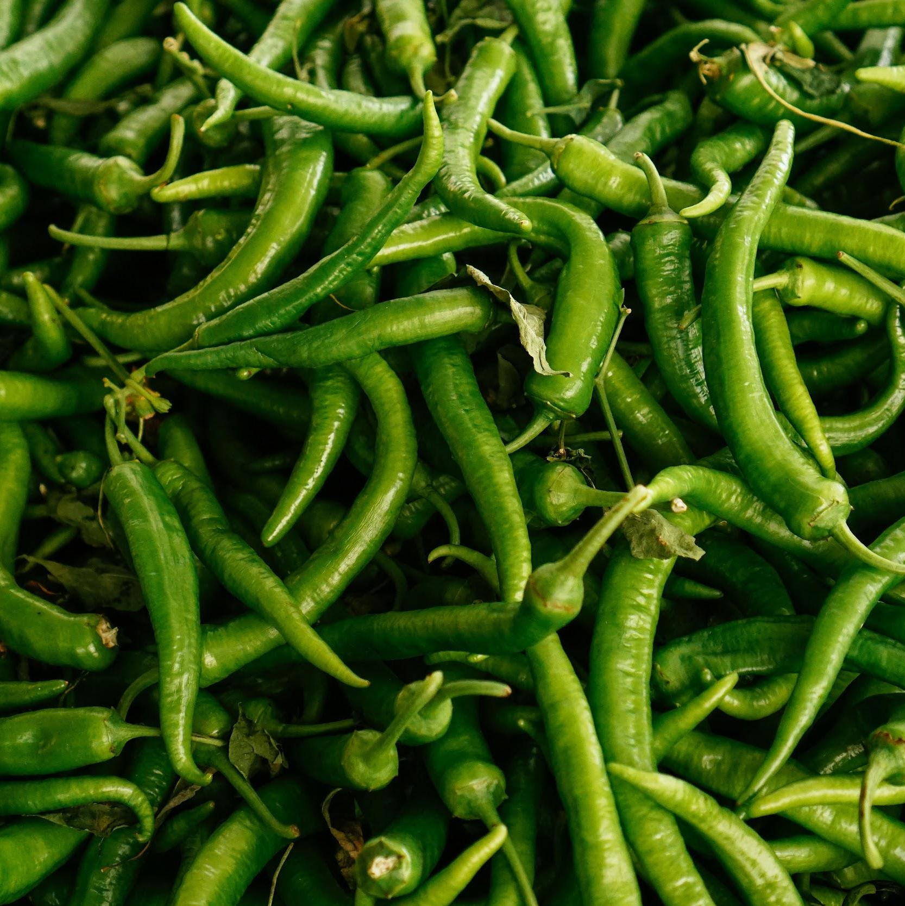
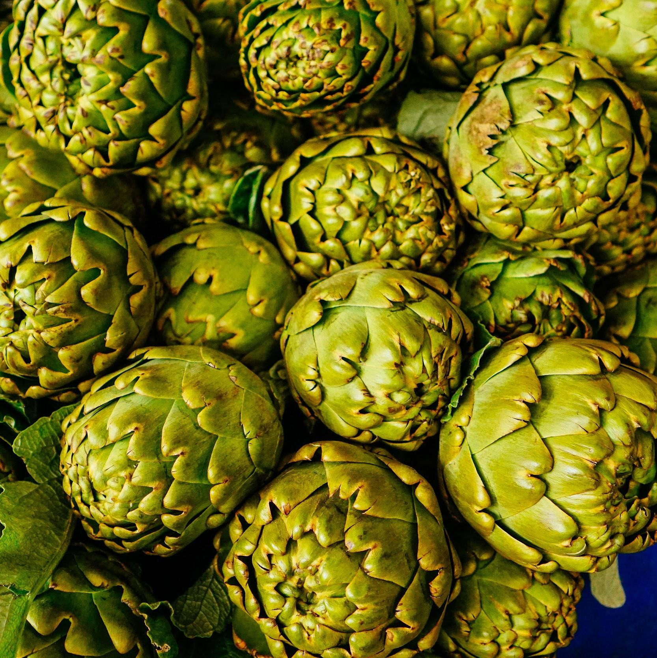
How can we solve this problem?
Shintsha is a decentralized blockchain solution which aims to grant remote organic farmers like Mr. Obi access to the mainstream market, foster transparency and promote unhindered access to their customers/investors through the use of WhatsApp enabled mobile phones, smart contracts on the blockchain and web3 service for storing the information on farmers, buyers, product, cost and delivery logistics.
Since the farmers have access to the mainstream market, and all these information are stored in the blockchain, it would mitigate discrepancies in product information, he would have a trusted platform to build his financial reputation which can then be used by him to seek for funds from financial institutions.
Mr. Obi can also supply goods to the international market and exchange payments through ETH/ERC20 token and also fiat, since investors has access to him and vice versa.

Slide 8



Similar platforms working on solving this?
Cellulant through the use of blockchain technology has a unified payment and e-commerce platform powering payments for 17 million farmers. The potential blockchain technology has– as a transparent and decentralized ledger in disrupting various sectors in Africa is irrefutable.
Agrikore -powered by Cellulant is an automated smart- contracting payments marketplace that offers digital financial services & customer relationship management system for Agriculture.
AgroMarketDay is a mobile application that features details of agricultural markets, market days , farmers, agriculture tools, agriculture news and the products sold in those markets in different districts in Uganda. This application enables farmers to upload information about their produce onto the system which will therefore be visible to anyone who has the application on their mobile phone.
Agriledger is a mobile phone solution based on blockchain technology that provides small-scale farmers with market price information and transparency about charges of middlemen, they have begun testing this in Kenya.

Slide 9
Product Market Fit

Slide 10
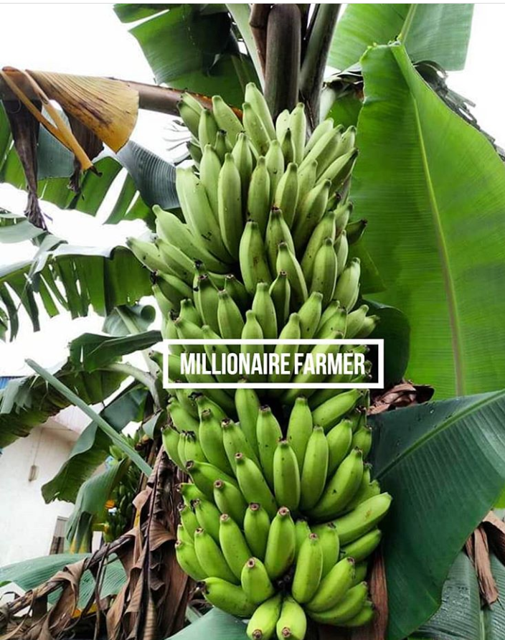
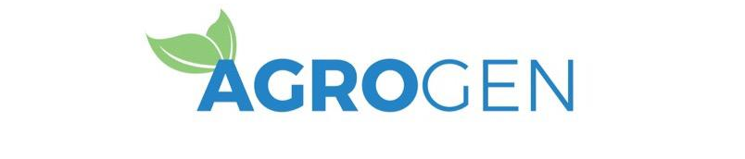
Industry Focus
Industry: Community Supported Agriculture (CSA)
CSAs are partnerships of mutual commitment between a farm and a community of supporters that provide a direct link between the production and consumption of food. Supporters usually cover a farm’s yearly operating budget by purchasing a share of the season’s harvest and in some cases they assist with the farm work. In return, the farm provides, to the best of its ability, a healthy supply of seasonal fresh produce.
Target: Organic Farmers
Granting owners of organic farms access to manage their finances and maintain contact with their CSA customers directly through the web 3.0, also organic farming is much needed because it fosters preservation of the environment.
Potential Early-Adopters:
Farmers
SMEs
Buyers/Investors

Slide 11
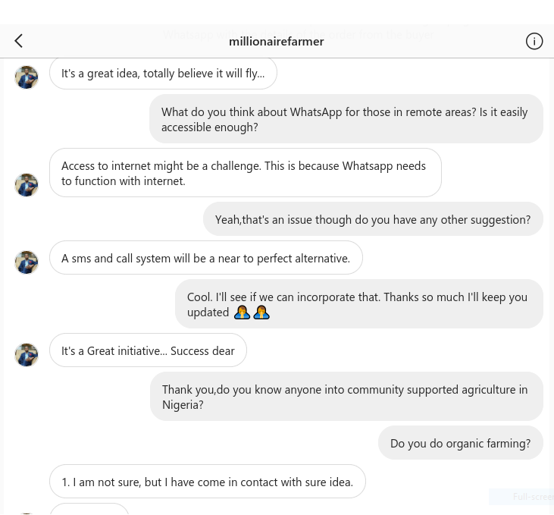
Industry Advisor 1
Hypothesis
Build a product using whatsapp API to enable farmers interact with their buyers/investors, farmer can save their details on Whatsapp,will be notified when buyers are interested, advertise their products on Shintsha via upload on whatsapp, which will be saved via smart contracts on the blockchain.
SME
We got in contact with Christian Okorode (CEO of Millionaire Farms, Nigeria) to validate the idea, he raised some concern regarding issues with internet in remote locations in Nigeria, and that an alternative could be to send an SMS prompt notifying the farmer to check their whatsapp messages from Shintsha, and also consented to trying out the app when it goes live.
Instagram handle: MillionaireFarmer

Slide 12

Industry Advisor 2
Hypothesis
Build a product using whatsapp API to enable organic farmers interact with CSA members, a farmer can register their farm and personal details on Whatsapp, and CSA members could also save their order, choose a farm, contribute to a pool system with other CSA members to fund the farmer all on SHINTSHA platform.
SME
We got in contact with Mouhamed Alassane Diallo and Ibrahima Diallo (CEOs of AGROGEN, Senegal) and validated the idea of remote organic farmers using whatsapp for their business because a vast majority has access to whatsapp-enabled phones, he also validated the CSA model and that it is very much welcomed in Senegal since they have a culture of supporting each other, he also said the CSA model is being practised in Senegal.
Instagram handle: AGROGEN
Voice recording from Mouhamed and Ibrahima Diallo
NB: Please listen to audio via google slides or powerpoint.

Slide 13
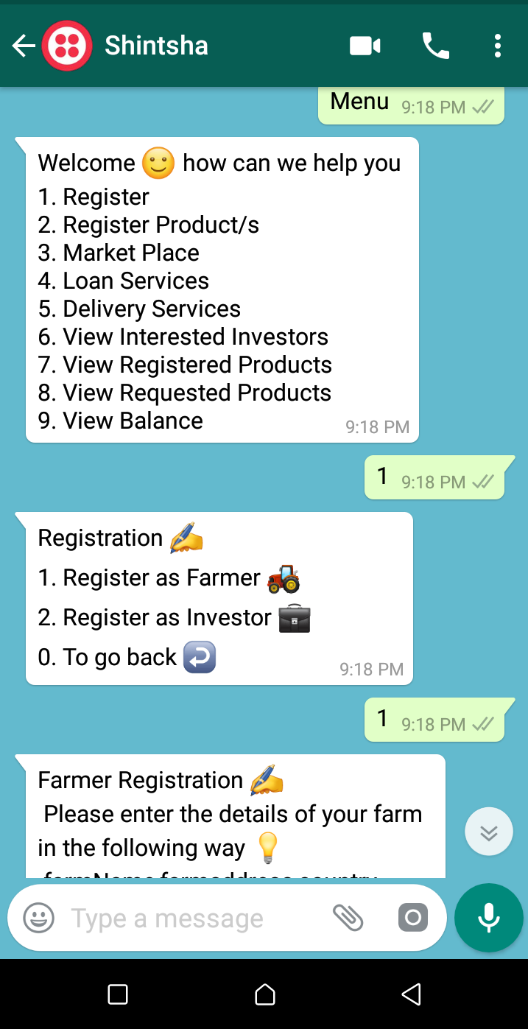
The Solution: Shintsha
Use case: Farmers can register on the Shintsha platform using their whatsapp enabled phones, farmers can also register products, view products, be notified when a buyer is interested in their product, etc.
Potential partners / clients:
Millionaire Farms
AGROGEN
SMEs
Solution: A decentralized UI for remote organic farmers to interact with buyers via whatsapp, receive orders from local and international investors and also gain access to soft loans in Africa. we chose whatsapp because of it’s encryption and security, and also Africa because blockchain has begun disrupting the agricultural sector, as evident by an article written by cellulant.
Benefits:
Reduce middlemen interference in Agriculture in Africa
Create valuable exchange between both parties (Matching demand and supply).
Promote organic farming and CSA in Africa
Enable access to loans for SMEs and farmers through a trust rated(Kudos & NFTs) system built overtime on Shintsha.

Slide 14
Why Blockchain?
The benefits of openness extend to all honest market participants. Blockchain technologies can prevent price extortion and delayed payments while simultaneously eliminating middlemen and lowering transaction fees. This can lead to fairer pricing and even help small-holder farmers capture a larger part of their crop value.
Blockchain promises to improve traceability and transparency within agriculture value chains. The ability to quickly trace the origin of food products would be an invaluable tool during contamination incidents. With blockchains, regulators can quickly identify the source of the contaminant and determine the scope of affected products. A more timely response by food companies can prevent illness, limit food waste, and contain financial fallout.
Blockchain technology could securely record information and trace products right from the small-scale farm all the way to consumers’ forks. This would not only satisfy consumers’ demand for provenance but allow farmers to build their reputations and charge more fair prices by comparing to similar transactions.

Slide 15
How does SHINTSHA work?

Slide 16
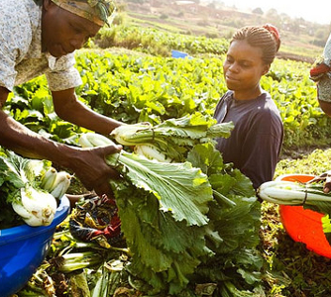
Parties Involved On The Shintsha Platform
Organic Farmers:
They represent SMEs (Farmers) in remote areas, who have whatsapp enabled phones and access to internet.
Buyers/CSA members:
They represent individuals or groups who wishes to purchase authentic, traceable produce/crops from the comfort of their homes via the internet.
Investors:
They could represent buyers/individuals, financial institutions,credit bureaus, and government agencies who wishes to invest in farms, and grant farmers access to soft loans to expand their businesses.

Slide 17
User Experience on the Shintsha Platform
Mr. Obi (Farmer) is fed-up on the current system of middlemen having the higher share from sales of his products and would love a system where he can directly interact with investors/buyers.
He’s introduced to Shintsha by a farmer friend,and is eager to use the Shintsha platform.
He adds the Shintsha Whatsapp number(+1 415 523 8886) as a contact on his mobile, he sends a prompt “join using-carried” and he’s connected to a twilio sandbox.
After Mr. Obi’s no is added to the sandbox, he can then send a prompt “Menu”, and receive a list of options such as register, register products, view balance, etc.
To register he clicks on no. 1, and is directed to input his farm name, farm address, country.
He receives a successfully registered message with a unique transaction receipt.
He can then register products, view market place products, view loan services available, delivery services etc.

Slide 18
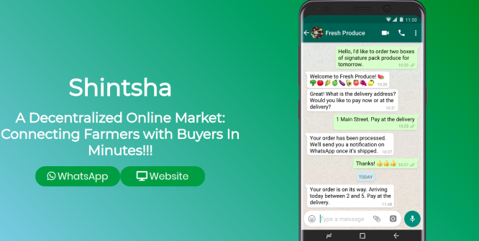
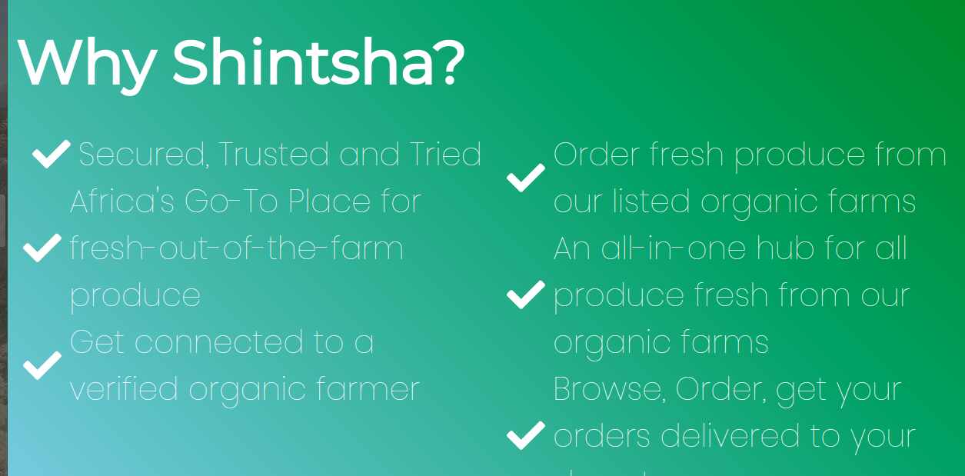
Prototype
We built a prototype (Shintsha) focused on enabling a high-level user-friendly experience for farmers in remote areas to access their buyers/investors in Africa through Whatsapp.
This prototype is to demonstrate to potential SMEs how the Shintsha platform works and how Farmers can use it to connect with investors/buyers.
The whatsapp no for Shintsha is: +1 415 523 8886, after which you can send a prompt: “join using-carried” to be added to the sandbox.

Slide 19
Prototype Details
LINKS
Demo: https://brianspha.github.io/Shinstha/
Github: https://github.com/Brianspha/Shinstha
LIMITATIONS
Track authenticity of farmers produce and their farms
Mr. Obi is a fictional use-case
Market price is not determined yet
FEATURE IMPLEMENTATION/ROADMAP
Connect with Verified Organic for authentication of farmers crops and farms.
Alternative sms prompt for farmers if internet is inaccessible, notification to buyers when ordered produce is available and ready for delivery.
International trade and delivery of goods to buyers/investors.
Access to soft loan implementation based on farmers documented reputation overtime.
Implement update of information on current market prices, eg prices of organic fertilizer, etc for farmers.
MAIN FEATURES
Shintsha smart contract will hold all information regarding Farmers, Farmer Products and buyers, Potential Investor. The contract will Inherit the ERC721 Full Token Contract.
Usage of Whatsapp by farmers for registration of their farms and products on Shintsha platform.
A web3 interface for buyers/investors to connect with farmers, and product listings.
Farmers can also accept payment in ETH/ERC20, and Fiat.
Delivery of goods and international payments.
Loan disbursement to farmers who have a reputation in kudos of upto 50 or NFTs of up to 100, this reputation is being given to the farmer by an investor or buyer who upvotes his profile after successful delivery of product.

Slide 20
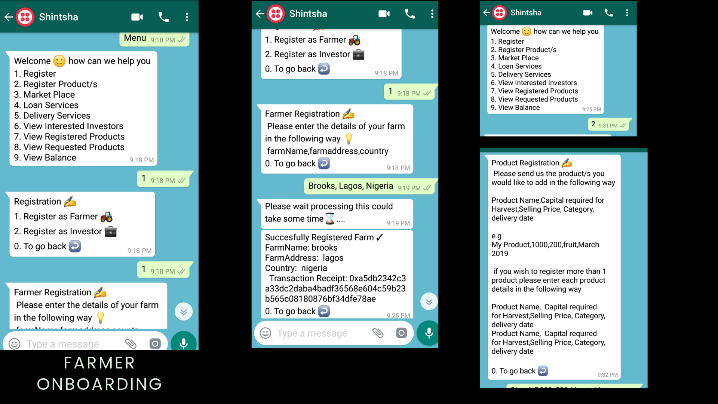
Shintsha: Farmer Onboarding UX Flow

Slide 21
Shintsha
CONCLUSION

Slide 22
Potential: The Decentralized Shintsha Farmer
The impact of mobile phones continues to be felt beyond the telecom sector as innovation to solve day to day problems are developed particularly for the agricultural sector. The penetration of mobile phones in Africa is currently at 44% according to the latest statistics from GSMA. The successful uptake of mobile phone by farmers in countries such as Nigeria and throughout Kenya has led to mobile innovations around some of the main challenges that farmers face: access to information, markets, and capital. The agricultural market in Africa is projected to grow to $1 Trillion by 2030. The sector is, however, an unsystematic and complex value chain that presents challenges in keeping and maintaining a database of all stakeholders; farmers, insurance companies, financial service providers, development partners and, governments. The use of blockchain technology has proved via transparency and immutability it’s capability in disrupting various sectors in Africa especially agriculture.
Source: Cellulant
INCENTIVES TO USE SHINTSHA
Secure, trusted and reliable
Easy access to buyers and investors by farmers.
Shared risk when using the CSA model.
Access to soft loans based on built reputation overtime.
Valuable exchange (trade between international markets and currencies both in eth/erc20 and fiat).
Low cost of transaction on the Shintsha platform.

Slide 23
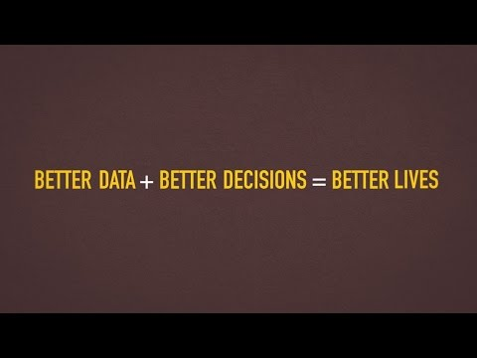
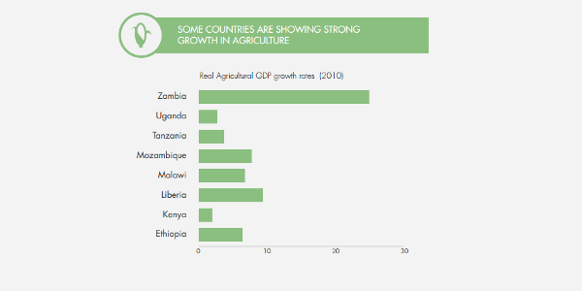
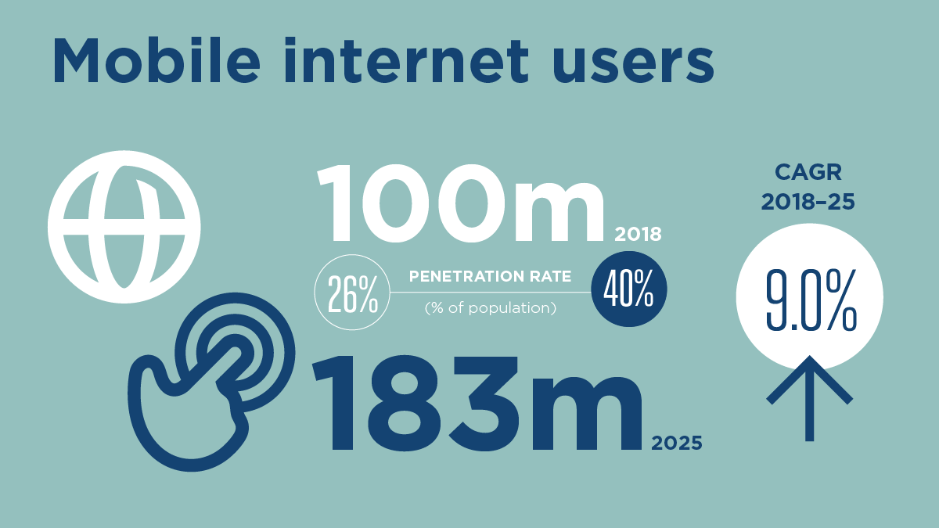
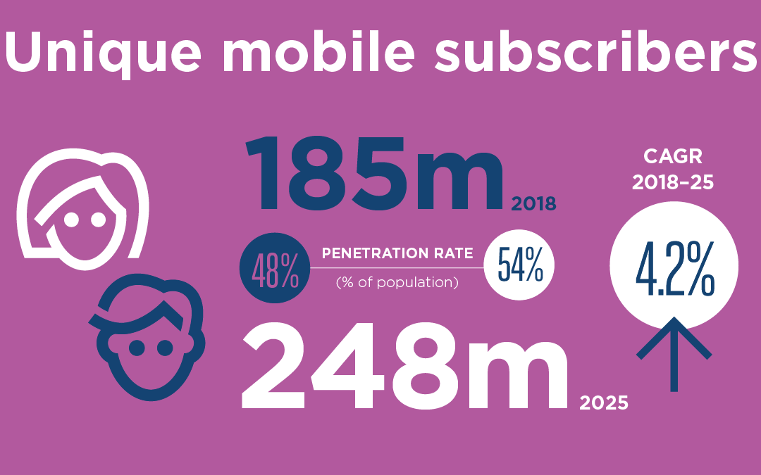
Attachment

Slide 24
Sources
https://www.cellulant.com/blog/blockchain-techology-in-africa/
https://play.google.com/store/apps/details?id=com.agromarketday&hl=en
http://www.agromarketday.com/
http://www.fao.org/e-agriculture/blog/how-blockchain-can-help-smallholder-farmers
http://www.agriledger.io/
https://www.ifoam.bio/en/community-supported-agriculture-csa
https://www.integrated-cbd.com/our-farms
https://www.verifiedorganic.io/
https://www.gsma.com/r/mobileeconomy/west-africa/
https://www.worldbank.org/en/news/video/2015/06/11/telling-myths-from-facts-africas-agricultural-data-gap
https://www.howwemadeitinafrica.com/agriculture-africa-potential-versus-reality/57635/
https://gro-intelligence.com/insights/articles/blockchain-in-agriculture

